Slide 1
MED 275 – Diagnosis and Screening
Bryant Lin, MD
September 25, 2024

Slide 2
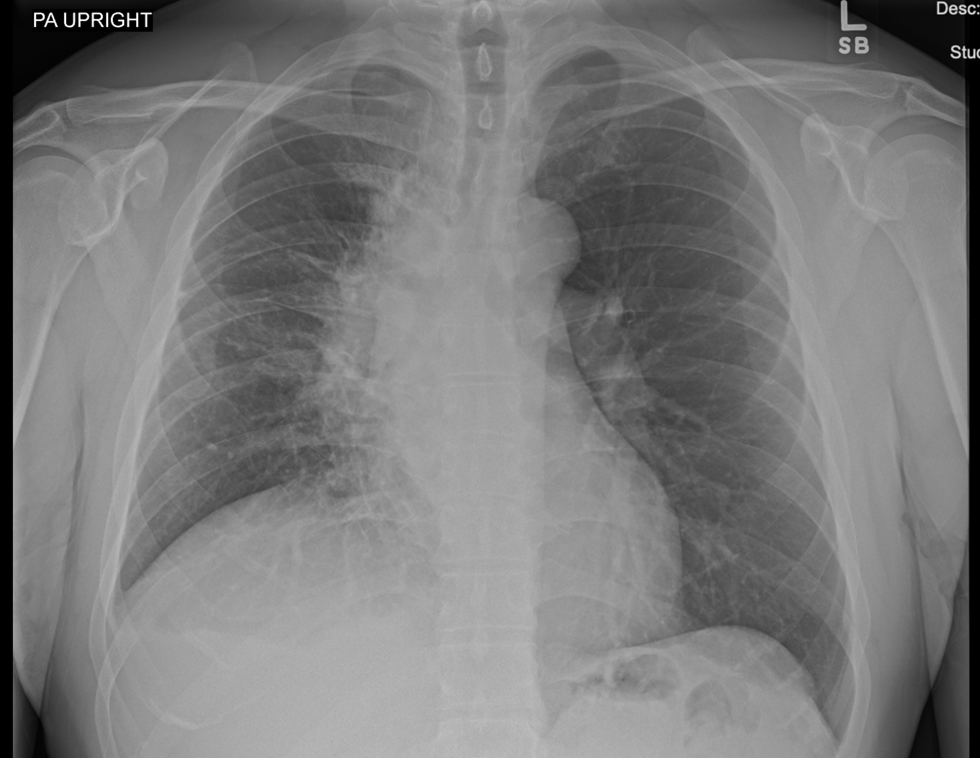
FINDINGS:
Elevated right hemidiaphragm and reduced right lung volumes are new from prior study. A new, 2 cm layer of pulmonary opacity covers the right mediastinal border from apex to base of the lung, with additional linear scars n the right mid lung. The left lung is clear. Size of the heart is probably normal. On the lateral view, there is a "donut" sign around the right upper lobe bronchus and lymphadenopathy is possible. The right posterior sulcus is blunted, may reflect a small right pleural effusion. No bony or soft tissue abnormality.
IMPRESSION:
1. New right lung changes since 9/2006 could reflect changes from radiation. But since we cannot be certain of chronicity, we cannot rule out acute infection or malignancy. Mediastinal lymphadenopathy and a right pleural effusion are possible. Recommend a chest CT with contrast for better evaluation.
May 7, 2024

Slide 3
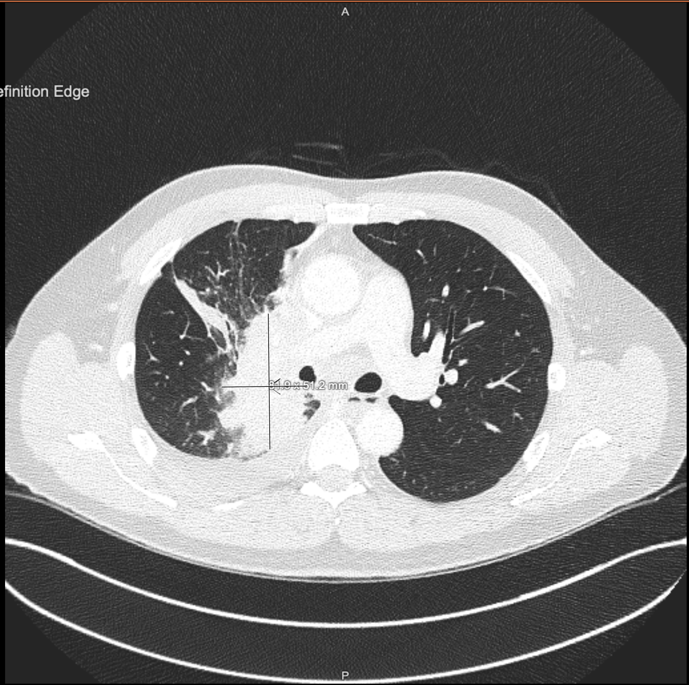
IMPRESSION:
1. Large right superior perihilar consolidation, with associated right hilar, mediastinal, and supraclavicular necrotic lymphadenopathy. There is associated right segmental airway narrowing with probable postobstructive consolidation/pneumonia. While these findings may reflect multilobar pneumonia (possibly tuberculous given necrotic lymphadenopathy), there is high suspicion for malignancy. Consider referral to pulmonology for possible tissue diagnosis.
2. Small-moderate right pleural effusion and small pericardial effusion, which may be reactive or malignant in nature.
3. Scattered left-sided nonspecific solid pulmonary nodules measuring up to 6 mm in the lingula. Attention on follow-up imaging.
4. Results were communicated to Dr. Ford by Dr. Parivash on 5/8/2024 at 1551
May 8, 2024

Slide 4
Pathology
May 10,2024
Diagnosis
A. Lymph Node, 4L, EBUS-Guided Fine Needle Aspiration • Metastatic poorly differentiated non-small cell carcinoma (see comment) B. Lymph Node, 7, EBUS-Guided Fine Needle Aspiration • Metastatic poorly differentiated non-small cell carcinoma (see comment) C. Lymph Node, 4R, EBUS-Guided Fine Needle Aspiration • Metastatic poorly differentiated non-small cell carcinoma (see comment) D. Lymph Node, 11RS, EBUS-Guided Fine Needle Aspiration • Metastatic poorly differentiated non-small cell carcinoma (see comment) E. Lymph Node, 11RI, EBUS-Guided Fine Needle Aspiration • Metastatic poorly differentiated non-small cell carcinoma (see comment)

Slide 5
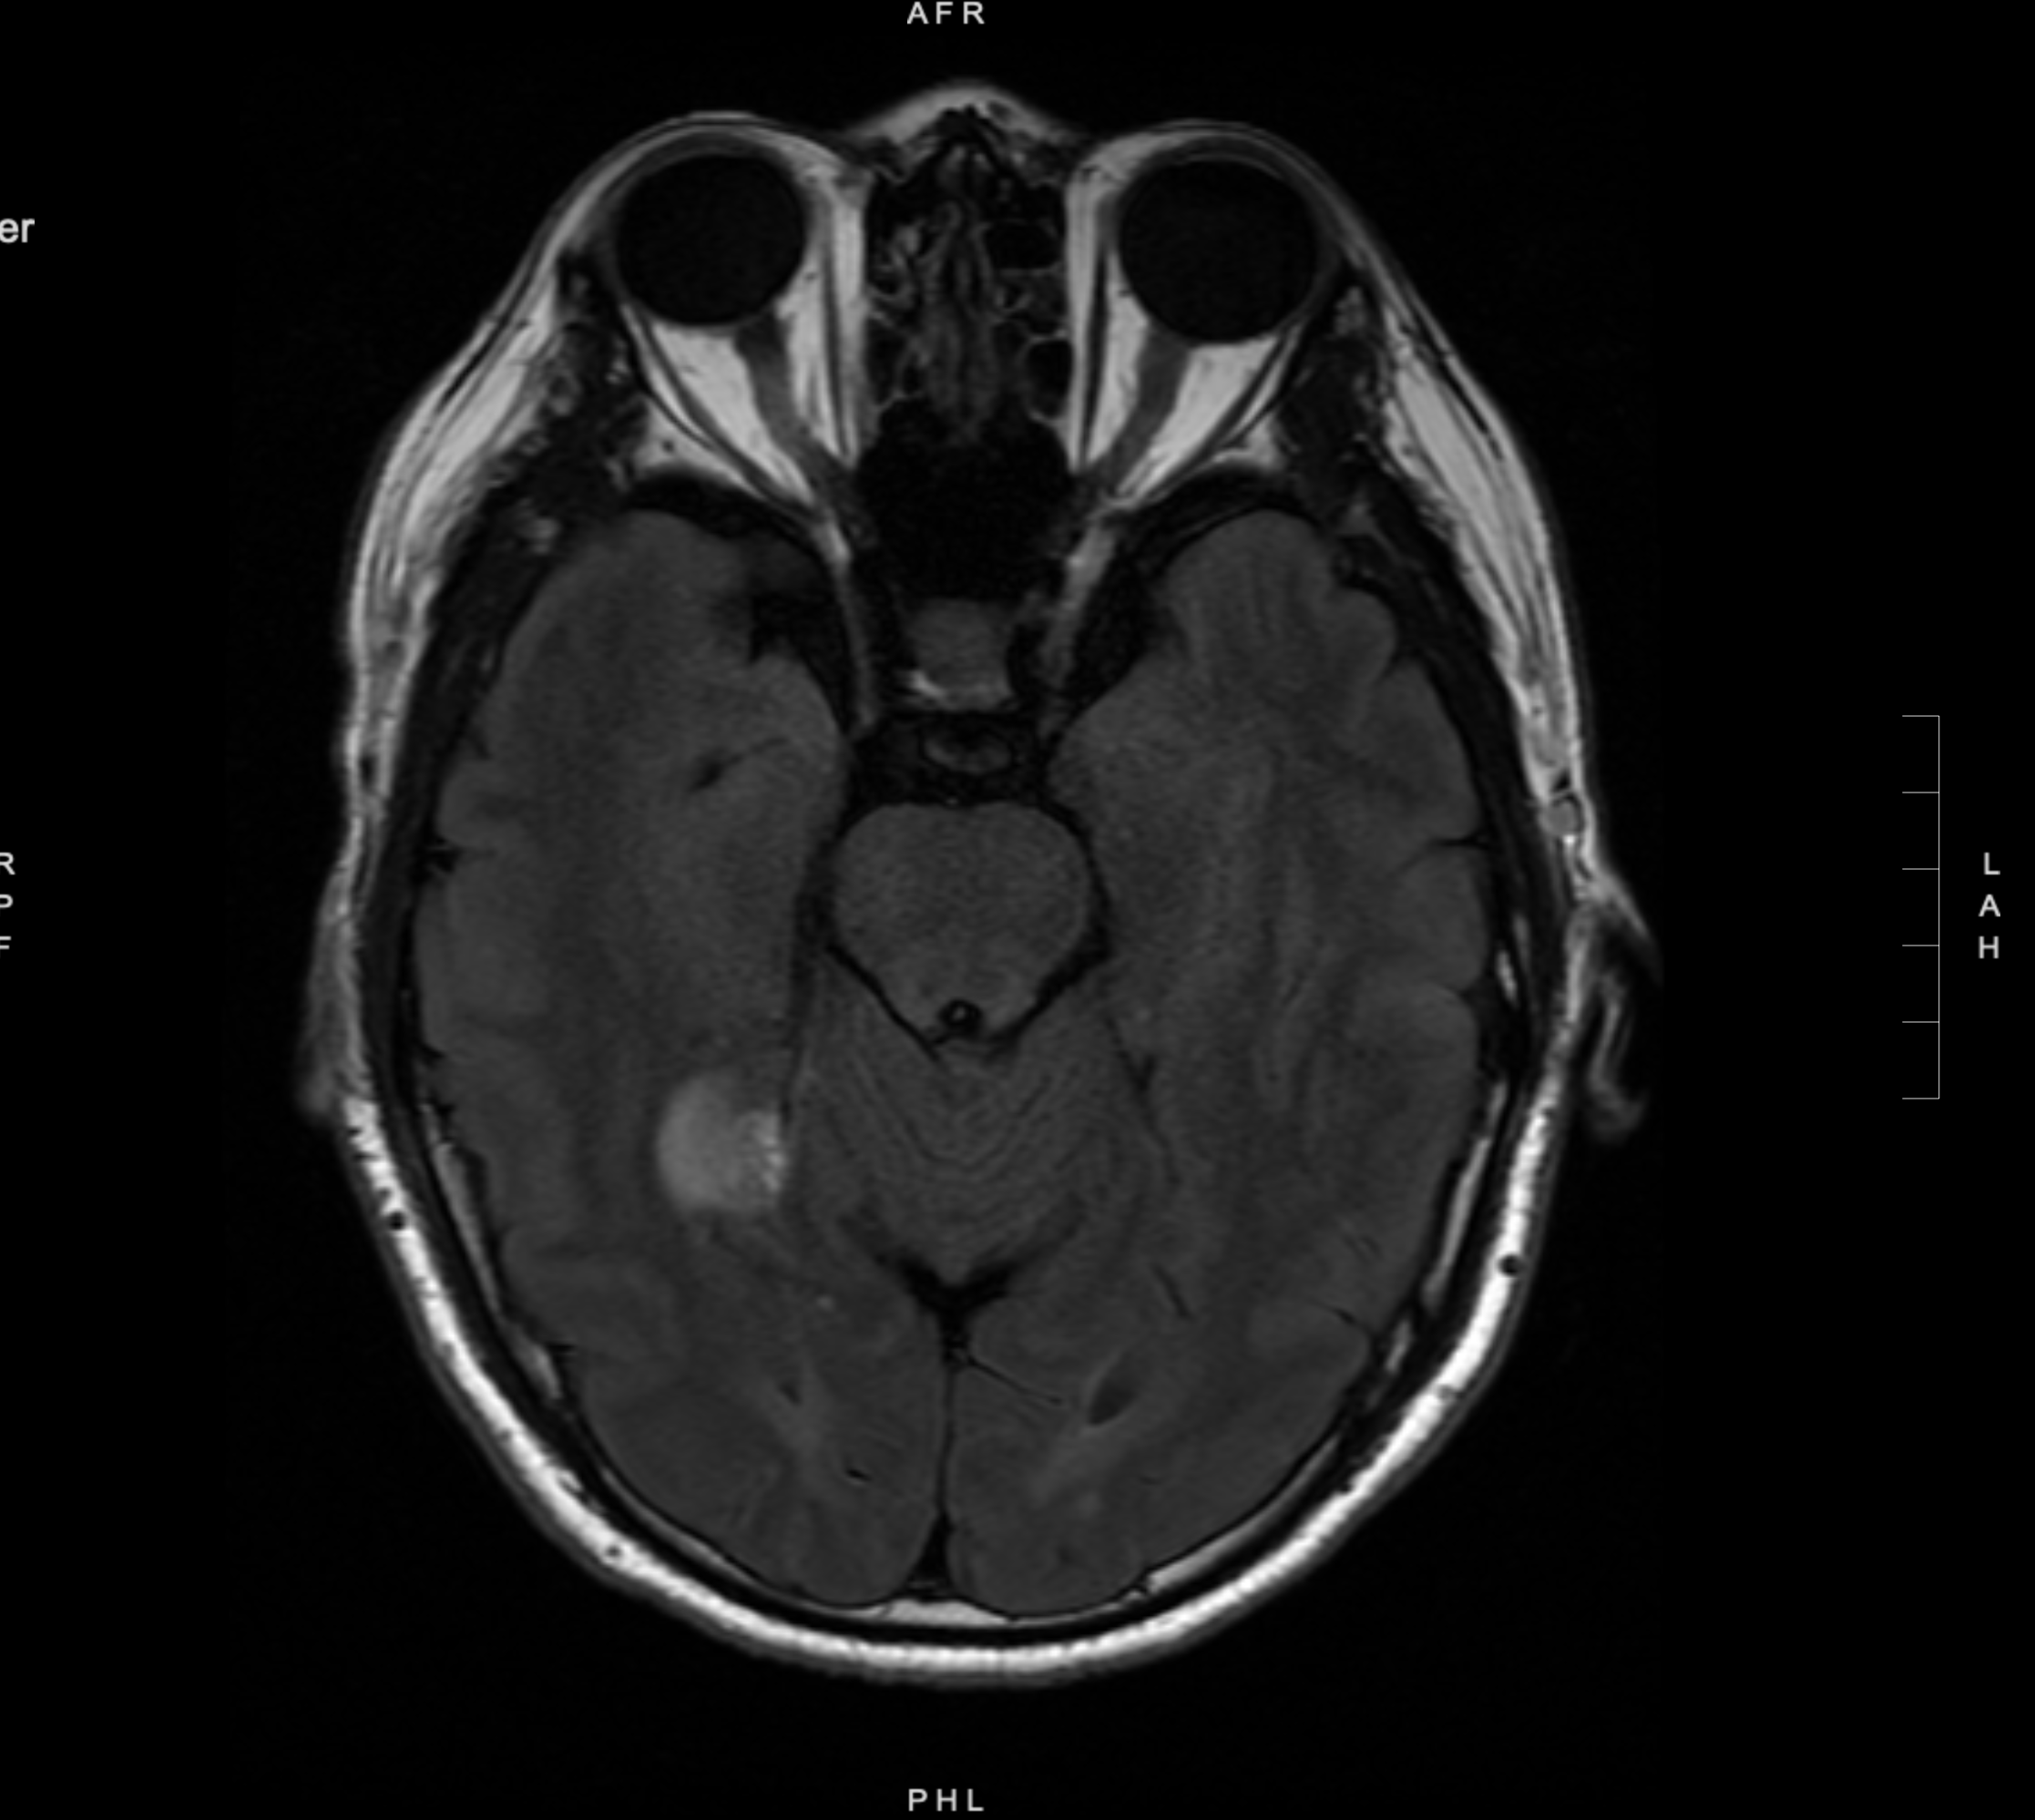
1. Numerous (approximately 50) enhancing lesions in the supratentorial and infratentorial parenchyma, concerning for intracranial metastases. Some of these lesions have mild perilesional edema.
2. 13 x 9 mm dural based, hyperperfused, enhancing lesion along the superior aspect of the right tentorial leaflet with mild perilesional edema in the lingual gyrus, also favored to represent a dural metastasis, less likely an incidental meningioma.
3. Mildly heterogenous and decreased bone marrow signal in the visualized upper cervical spine, which may be red marrow reconversion. No focal suspicious marrow replacing lesion. Recommend attention on upcoming PET/CT.
May 15, 2024

Slide 6
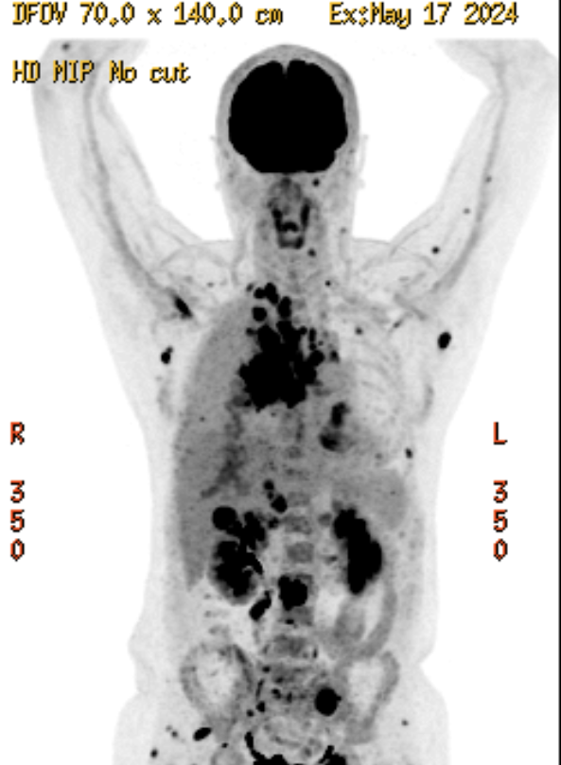
1. Infiltrative large hypermetabolic right perihilar lung mass consistent with primary bronchogenic malignancy with now complete collapse of the right upper lobe and partial atelectasis of the right middle lobe of the lung. Moderate size right pleural effusion with hypermetabolic right pleural metastases. Small pericardial effusion also concerning for malignant effusion.
2. Multiple hypermetabolic right supraclavicular and mediastinal and right hilar lymphadenopathy.
3. Multiple hypermetabolic osseous lesions, soft subcutaneous and intramuscular lesions, right adrenal lesions, right hepatic lobe lesion highly concerning for metastatic disease.
4. Mild hypermetabolic focus noted in the pancreatic body/peripancreatic region without CT correlate, indeterminate, metastasis is not excluded. Attention on follow-up imaging.
5. Intense FDG uptake noted in the mid and the right abdomen without CT correlate, indeterminate may represent physiologic bowel activity however in this patient with extensive metastatic disease, small bowel metastasis cannot be excluded. Further evaluation with CT with contrast is recommended.
6. A lytic metastases in the spinous process in the posterior elements posterior lamina of the L3 vertebra with extraosseous soft tissue extension and extension into the posterior epidural space. Further evaluation with MRI is recommended.
May 17, 2024

Slide 7
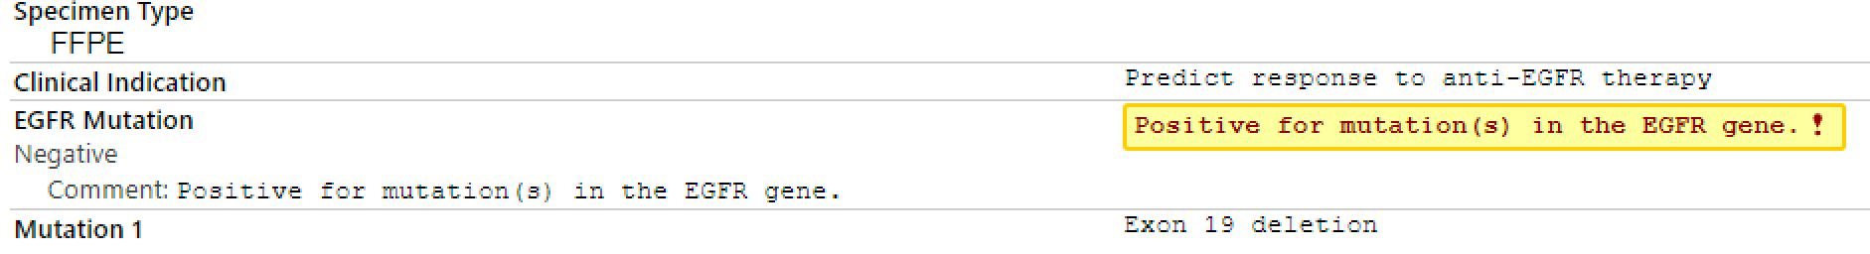
Molecular Diagnostics
May 17, 2024

